Slide 1
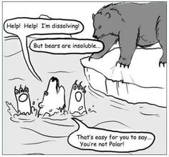

Slide 2
A2 CHemistry
Intermolecular Forces

Slide 3
Review
Draw electron dot diagram for calcium carbonate, hydrogen chloride, calcium chloride, water and carbon dioxide. Classify each as ionic and/or covalent, and then state the shape and polarity for any covalent molecules.
Write a balanced ionised equation for calcium carbonate solid reacting with hydrochloric acid.
If the above reaction has H of -15.2 kJmol ⁻¹ sketch its enthalpy diagram.

Slide 4
Learning Intentions
the shape and polarity of molecules can be used to explain and predict the nature and strength of intermolecular forces, including dispersion forces, dipole-dipole forces and hydrogen bonding

Slide 5
Success criteria
Draw electron dot diagrams
Draw Lewis structure
Identify as polar, non-polar and draw dipole
Define, describe and compare dispersion forces, dipole-dipole and hydrogen bonding
State that H-NOF bonds must exist for hydrogen bonding to occur
Explain why dispersion forces become significant in large molecules.

Slide 6
Key words
intermolecular
intramolecular
dipole
dipole-dipole
hydrogen bonding
dispersion

Slide 7
Intermolecular forces
between molecules
depends on polarity

Slide 8
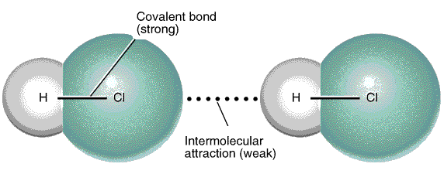
Dipole-dipole
medium strength
occurs between polar molecules
polar bonds and asymmetrical molecules

Slide 9
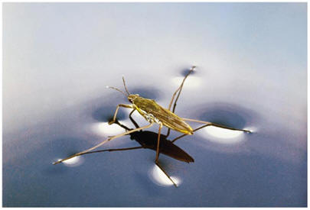
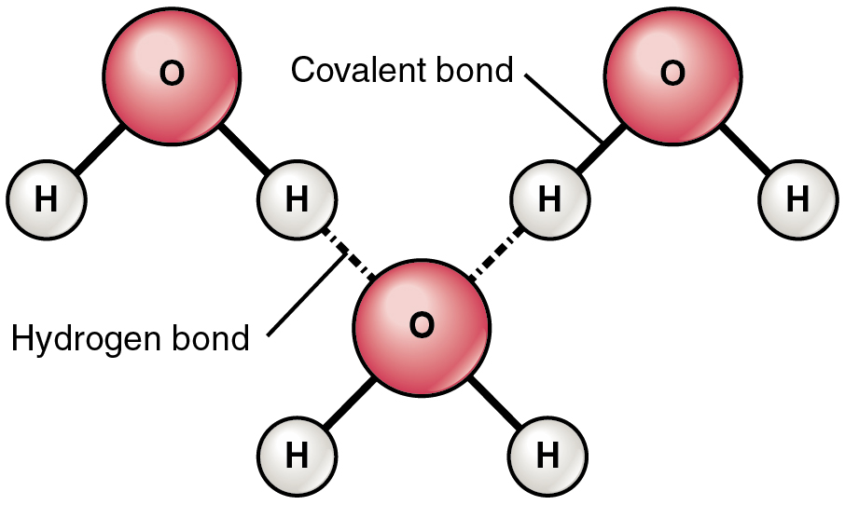
Hydrogen bonding
strongest intermolecular bonding
occurs between extremely polar molecules
H-NOF

Slide 10
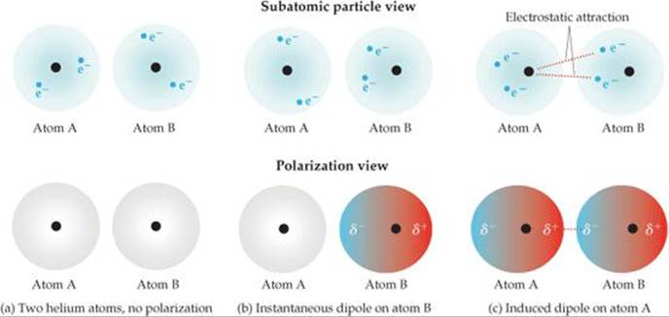
Dispersion
weakest intermolecular force
occurs between non polar “pure covalent” molecules
temporary dipole

Slide 11
Bonding continuum
MP/BP
Low High
Dispersion Dipole-dipole H-Bonding Metallic Ionic Covalent (Pure covalent) (Polar covalent) network
Strength of bonding
Weak Strong

Slide 12
Success criteria
Draw electron dot diagrams
Draw Lewis structure
Identify as polar, non-polar and draw dipole
Define, describe and compare dispersion forces, dipole-dipole and hydrogen bonding
State that H-NOF bonds must exist for hydrogen bonding to occur
Explain why dispersion forces become significant in large molecules.

